Slide 1
Controllers over Internet
Tomas Husak

Slide 2
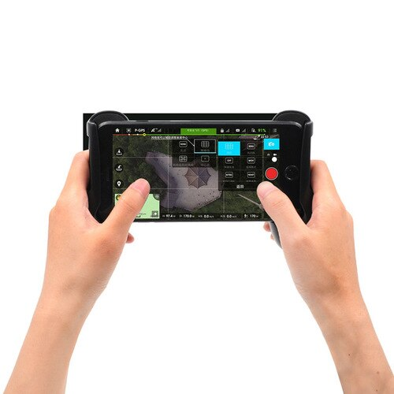
Problem
Don’t install unnecessary application
Let you browser be a gamepad
Find universal way how to make this feature extensible

Slide 3
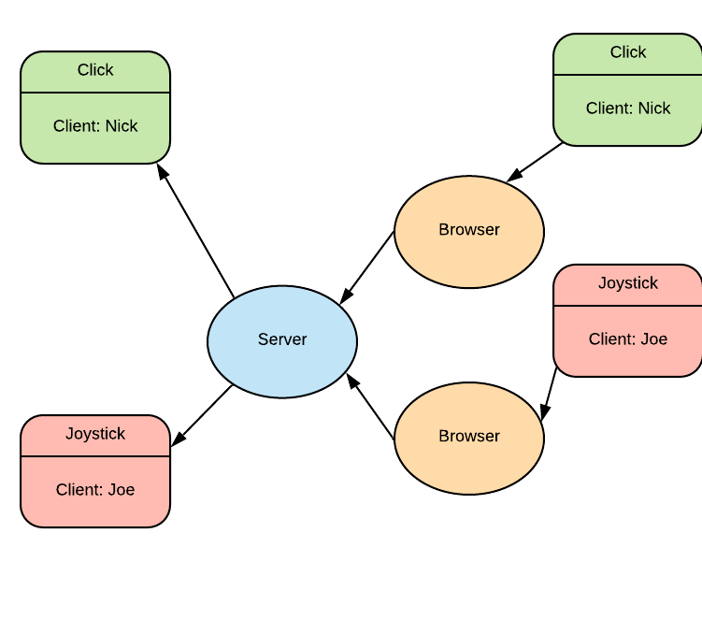
Idea of solution
Blazor web assembly
ASP.NET Core

Slide 4
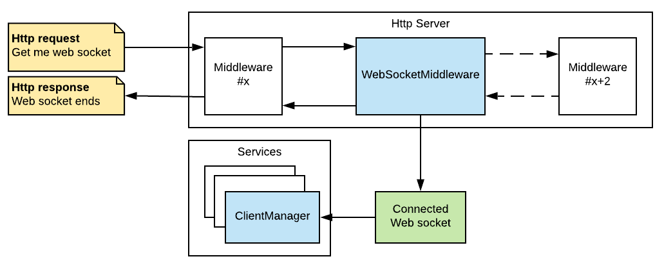
Pipeline

Slide 5
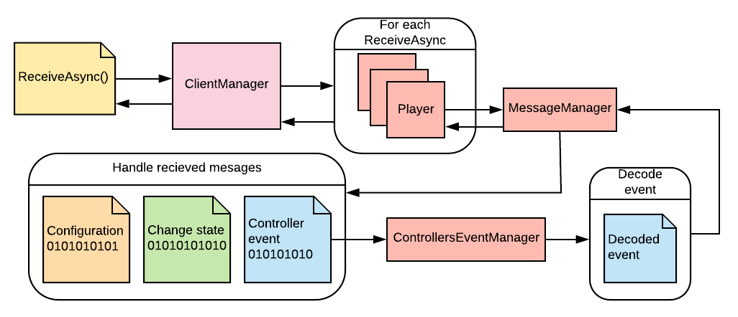
Client management

Slide 6
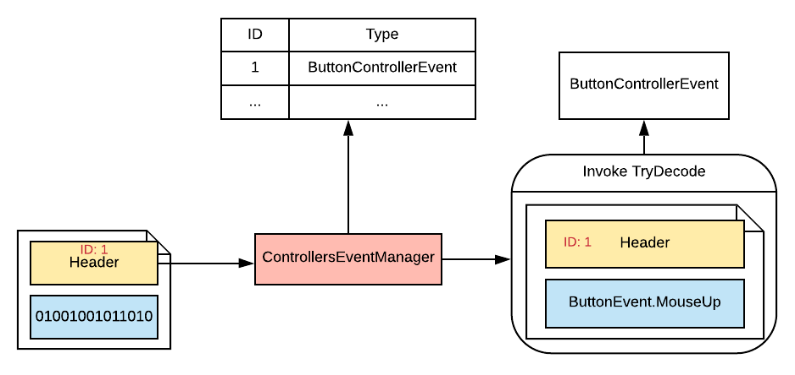
Event

Slide 7
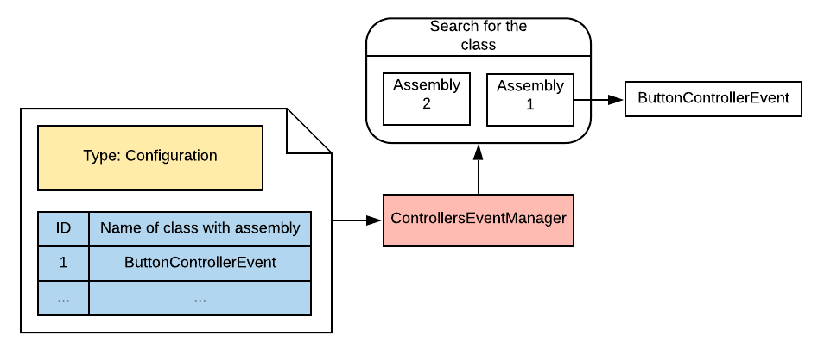
Finding .NET class

Slide 8
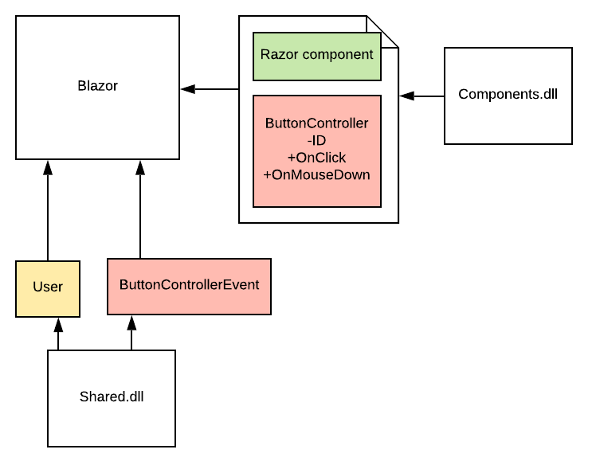
Blazor

Slide 9
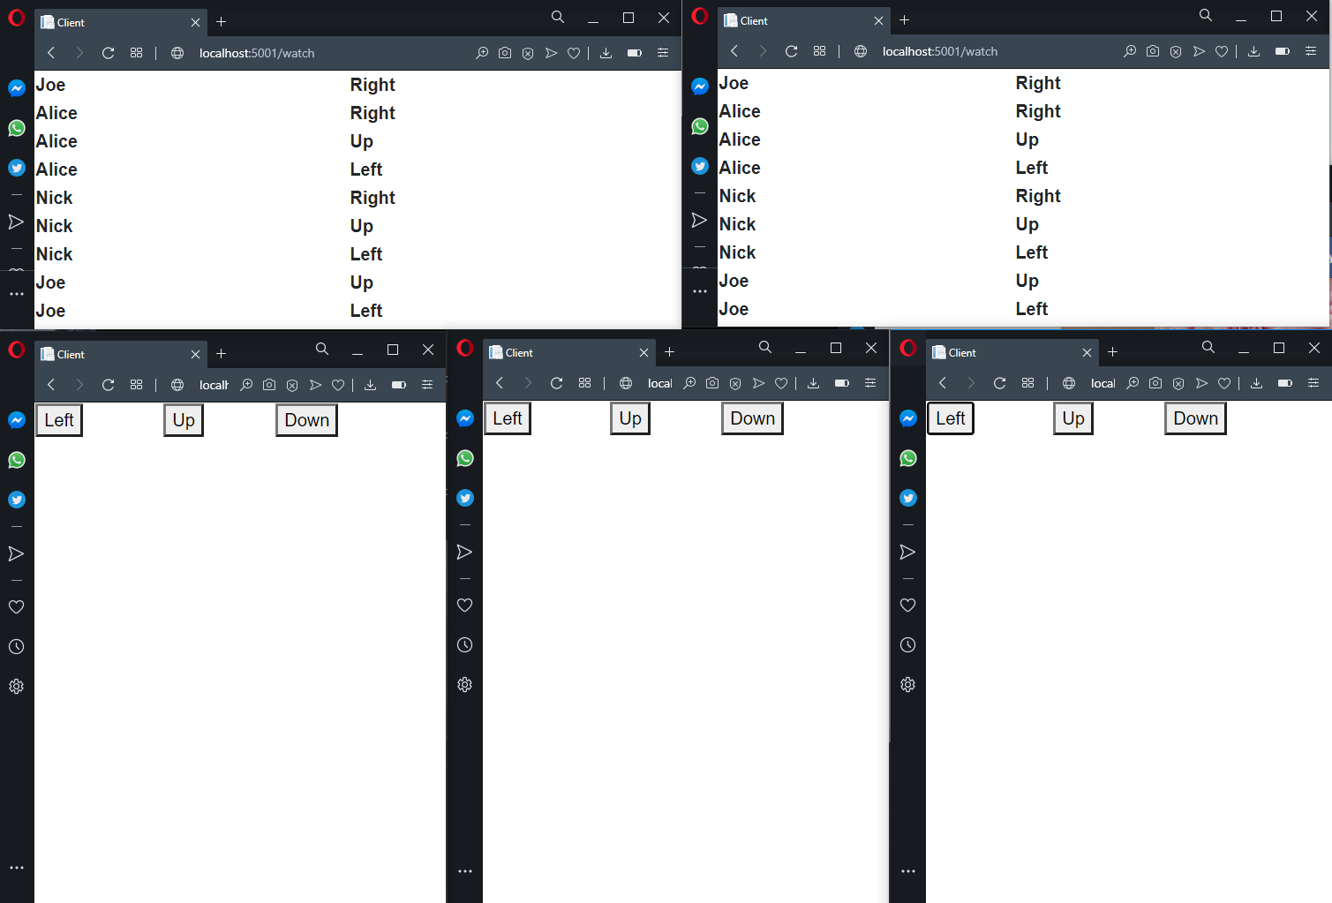
Example

